Slide 1

Natural Language Processing DLO 8012
Subject In-charge
Ms Vincy Joseph
Assistant Professor
email: vincyjoseph@sfit.ac.in

Slide 2
Module V
Lecture 28 Discourse Integration

Slide 3
Discourse Model
The discourse model contains representations of the entities that have been referred to in the discourse and the relationships in which they participate.
There are 2 fundamental operations to discourse model.
When a referent is first mentioned in a discourse, we say that a representation for it is evoked into the model.
Upon subsequent mention, this representation is accessed from the model.

Slide 4
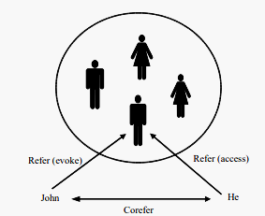
Discourse Model
Example:
John went to Bill’s car dealership to check out an Acura Integra. He looked at it for about an hour.

Slide 5
Reference Phenomena
There are several referential phenomena in natural languages.
Five among them explored here are:
Indefinite noun phrases, definite noun phrases, pronouns, demonstratives and one-anaphora.
Three types of referents complicate the reference resolution problem:
Inferrables, discontinuous sets, and generics.

Slide 6
Indefinite Noun Phrases
Indefinite reference introduces entities that are new to the hearer into the discourse context.
Common form of indefinite reference is marked with the determiner a (or an),by a quantifier (some) or even determiner this.
I saw a Mercedes Benz today.
Some Mercedes Benz were being unloaded at the local dealership today.
I saw this awesome Mercedes Benz today.

Slide 7
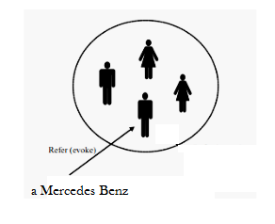
Indefinite Noun Phrases
Such noun phrases evoke a representation for a new entity.

Slide 8
Definite Noun Phrases
Deﬁnite reference is used to refer to an entity that is
identiﬁable to the hearer
it is contained in the hearer’s set of beliefs about the world
the uniqueness of the object is implied by the description itself.
E.g.
I saw an Acura Integra today. The Integra was white and needed to be washed.
The Indianapolis 500 is the most popular one in US.
The fastest car in the Indianapolis 500 was an Integra.

Slide 9
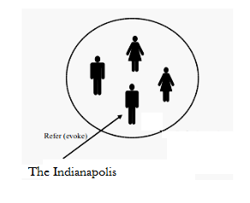
Definite Noun Phrases
A Definite Noun Phrase also evokes a representation of the referent into the discourse model.

Slide 10
Pronouns
Pronominalization is another form of deﬁnite reference
E.g. I saw an Acura Integra today. It was white and needed to be washed.
The constraints on using pronouns is that it should refer to entities that were introduced no further than one or two sentences back in the ongoing discourse, whereas deﬁnite noun phrases can often refer further back.

Slide 11
Example
a. John went to Bob’s party, and parked next to a beautiful Acura Integra.
b. He went inside and talked to Bob for more than an hour.
c. Bob told him that he recently got engaged.
d. He also said that he bought it yesterday.
d’. He also said that he bought the Acura yesterday.
By the time the last sentence is reached, the Integra no longer has the degree of salience required to allow for pronominal reference to it

Slide 12
Pronouns as Cataphora
Pronouns are mentioned before their referents are called Cataphoras
E.g. Before he bought it, John checked over the Integra very carefully.
Here, the pronouns he and it both occur before their referents are introduced.

Slide 13
Demonstratives
Demonstrative pronouns, like this and that, can appear either alone or as determiners (this Acura, that Acura).
The choice between two demonstratives is based on spatial proximity:
this indicating closeness and
that signaling distance.
Spatial distance might be measured with respect to the discourse participants situational context.

Slide 14
Demonstratives
E.g. I bought an Integra yesterday. It’s similar to the one I bought ﬁve years ago. That one was really nice, but I like this one even better.
Here, that one refers to the Acura bought ﬁve years ago (greater temporal distance), whereas this one refers to the one bought yesterday (closer temporal distance).

Slide 15
One Anaphora
One-anaphora, blends properties of deﬁnite and indeﬁnite reference.
E.g.
She has a white car. I also want one
She has the best BMW. I also want one like that.
This usage is paraphrased by one of them, in which ‘them’ refers to a plural referent & one is a member from this set.
Thus, one may evoke a new entity which is dependent on an existing referent.

Slide 16
One Anaphora
This use of one should be distinguished from the formal, non-speciﬁc pronoun usage and its meaning as the number one as shown below.
E.g.
One shouldn’t pay more than twenty thousand dollars for an Acura.
John has two Acuras, but I only have one.

Slide 17
Lec 29

Slide 18
Referents complicate the reference resolution problem

Slide 19
Inferrables
Consider cases in which a referring expression does not refer to an entity that has been explicitly evoked in the text, but instead one that is inferentially related to an evoked entity. Such referents are called inferrables.
E.g. I almost bought an Acura Integra today, but a door had a dent and the engine seems noisy.
The indeﬁnite noun phrase a door would evoke a new door into the discourse context, but in this case infer : that it is not just any door, but one of the doors of the Integra.
Similarly, no engine has been explicitly mentioned, but the hearer infers that the referent is the engine of Integra.

Slide 20
Inferrables
Inferrables can also specify the results of processes described by utterances in a discourse. Consider the possible follow-ons (a-c) to sentence in the following recipe :
Mix the ﬂour, butter, and water.
a. Kneed the dough until smooth and shiny.
b. Spread the paste over the blueberries.
c. Stir the batter until all lumps are gone.
Any of the expressions the dough (a solid), the batter (a liquid), and the paste (somewhere in between) can be used to refer to the result of the actions described in the ﬁrst sentence, but all imply different properties of this result.

Slide 21
Discontinuous Sets
In some cases, references using plural referring expressions like they and them refer to sets of entities that are evoked together.
E.g. John and Mary love their Acuras. They drive them all the time.
However, plural references may also refer to sets of entities that have been evoked by discontinuous phrases in the text:
E.g.John has an Acura, and Mary has a Mazda. They drive them all the time.
Here, they refers to John and Mary, and likewise them refers to the Acura and the Mazda.

Slide 22
Generics
Consider the example given below:
E.g. I saw no less than 6 Acura Integras today. They are the coolest cars.
Here, the most natural reading is not the one in which they refers to the particular 6 Integras mentioned in the ﬁrst sentence, but instead to the class of Integras in general.

Slide 24
Syntactic and Semantic Constraints on Coreference

Slide 25
Syntactic and Semantic Constraints
How one develop algorithms for identifying the referents of referential expressions.
One step is to ﬁlter the set of possible referents on the basis of certain relatively hard-and-fast constraints.
Let us see some of these constraints

Slide 26
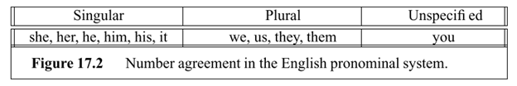
Number Agreement
Referring expressions and their referents must agree in number
This means distinguishing between singular and plural references.

Slide 27
Number Agreement
The following examples illustrate constraints on number agreement.
E.g.
John has a new Acura. It is red.
John has three new Acuras. They are red.
* John has a new Acura. They are red.
* John has three new Acuras. It is red.

Slide 28
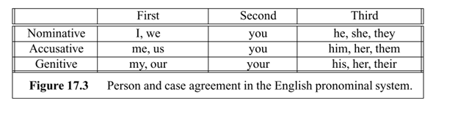
Person and Case Agreement
English distinguishes between three forms of person: ﬁrst, second, and third.

Slide 29
Person and Case Agreement
E.g.
You and I have Acuras. We love them.
John and Mary have Acuras. They love them.
* John and Mary have Acuras. We love them. (where We=John and Mary)
* You and I have Acuras. They love them. (where They=You and I)

Slide 30
Person and Case Agreement
Different forms of the pronoun may be required when placed in
subject position ( e.g., he, she, they)
object position ( e.g., him, her, them)
genitive position ( e.g., his Acura, her Acura, their Acura).

Slide 31
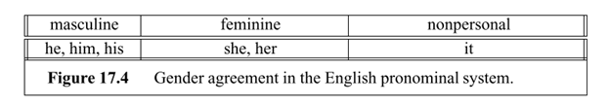
Gender Agreement
Referents also must agree with the gender speciﬁed by the referring expression.
English third person pronouns distinguish between male, female, and nonpersonal genders

Slide 32
Gender Agreement
E.g.
John has an Acura. He is attractive. (he=John, not the Acura)
John has an Acura. It is attractive. (it=the Acura, not John)

Slide 33
Syntactic Constraints
References are constrained by the syntactic relationships between a referential expression and a possible antecedent noun phrase when both occur in the same sentence.

Slide 34
Syntactic Constraints
E.g
John bought himself a new Acura. [himself = John]
John bought him a new Acura. [him ≠John]
John said that Bill bought him a new Acura. [him ≠ Bill]
John said that Bill bought himself a new Acura. [himself =Bill]
He said that he bought John a new Acura. [He ≠ John] [he ≠ John]

Slide 35
Reflexive Constraints
English pronouns such as himself, herself, and themselves are called reﬂexives.
A reﬂexive corefers with the subject of the most immediate clause that contains it
E.g. John bought himself a new Acura. [himself = John]
A nonreflexive cannot corefer with this subject
E.g. John bought him a new Acura. [him ≠John].

Slide 36
Reflexive Constraints
A nonreﬂexive pronoun like him can corefer with the subject of the previous sentence
E.g. John wanted a new car. Bill bought him a new Acura. [him=John]
but it cannot in
E.g. John wanted a new car. He bought him a new Acura.[He=John,him ≠John]
because of its syntactic relationship

Slide 37
Reflexive Constraints
There are many cases that they do not cover.
E.g. John set the pamphlets about Acuras next to himself. [himself=John]) and
E.g. John set the pamphlets about Acuras next to him. [him=John])
Both can refer to the subject John, even though they occur in identical syntactic conﬁgurations.

Slide 38
Selectional Restrictions
The selectional restrictions that a verb places on its arguments may be responsible for eliminating referents.
E.g. John parked his Acura in the garage. He had driven it around for hours.
A practical NLP system would include a reasonably comprehensive set of selectional constraints for the verbs in its lexicon.

Slide 39
Selectional Restrictions
Selectional restrictions can be violated in the case of metaphor.
E.g. John bought a new Acura. It drinks gasoline like you would not believe
E.g. John parked his Acura in the garage. It is incredibly messy, with old bike and car parts lying around everywhere.

Slide 40
Selectional Restrictions
Thus, any knowledge shared by the discourse participants might be necessary to resolve a pronoun reference.
However, due in part to the vastness of such knowledge, practical algorithms typically do not rely on it heavily.

Slide 41
Preferences in Pronoun Interpretation
Here we look into different methodologies used for pronoun resolution

Slide 42
1. Recency
Most theories assumes that entities introduced in recent utterances are more salient than those utterances further back.
E.g.
John has an Integra. Bill has a Legend. Mary likes to drive it.
(Here it is presumed that Mary likes to drive Legend)

Slide 43
2. Grammatical Role
Some theories specify a salience hierarchy of entities ordered by the grammatical position of the expressions.
It treat entities mentioned in subject position as more salient than those in object position, which are in turn more salient than subsequent positions.

Slide 44
2. Grammatical Role
E.g.
John went to the Acura dealership with Bill. He bought an Integra. [ he = John ]
Bill went to the Acura dealership with John. He bought an Integra. [ he = Bill ]
John and Bill went to the Acura dealership. He bought an Integra. [ he = ?? ].

Slide 45
Repeated Mention
Some theories incorporate the idea that entities that have been focused on in the prior discourse are more likely to continue to be focused on in subsequent discourse
E.g.
John needed a car to get to his new job. He decided that he wanted something sporty. Bill went to the Acura dealership with him. He bought an Integra. [ he = John]

Slide 46
Parallelism
There are also strong preferences that appear to be induced by parallelism effects.
E.g.
Mary went with Sue to the Acura dealership. Sally went with her to the Mazda dealership. [ her = Sue ]

Slide 47
Heuristics
This suggests that we might want a heuristic which says that non-subject pronouns prefer non-subject referents.
Consider the following example in which Mary is the preferred referent of the pronoun instead of Sue.
E.g.
Mary went with Sue to the Acura dealership. Sally told her not to buy anything. [ her = Mary ]

Slide 48
Verb Semantics
Certain verbs appear to place a semantically-oriented emphasis on one of their argument positions based on the manner in which subsequent pronouns are interpreted.
Based on Subject:
E.g. John telephoned Bill. He lost the pamphlet on Acura.[He = John]
John criticized Bill. He lost the pamphlet on Acura. [He = Bill]

Slide 49
Verb Semantics
Based on Goal Thematic Role:
E.g.
John seized the Acura pamphlet from Bill. He loves reading about cars. (Goal=John, Source=Bill)
John passed the Acura pamphlet to Bill. He loves reading about cars. (Goal=Bill, Source=John)

Slide 50
Verb Semantics
Based on Stimulus Experiencer Role:
E.g.
The car dealer admired John. He knows Acuras inside and out. (Stimulus=John, Experiencer=the car dealer)
The car dealer impressed John. He knows Acuras inside and out. (Stimulus=the car dealer, Experiencer=John)

Slide 51
Lappin and Leass Algorithm for Pronoun Resolution

Slide 52
Revision of English Grammar

Slide 53
Subject
The pronoun, noun or noun phrase that does the action of the verb
Subject is usually before the verb
E.g.
John Arrived.
I love chocolate
It can also be a group of words
E.g.
An orange cat was sitting beside me

Slide 54
Subject
Some verbs are not actions but linking verbs that links to more information about the subject
Linking Verbs : be, seem, become
E.g.
I am hungry
John seemed tired
Subjects can be long
E.g.
The man who lives upstairs lied

Slide 55
Subject
Subjects can include 2 or more nouns
E.g.
Lucy’s grey cat and John’s white cat are friends

Slide 56
Object
It is a thing or person that the verb is done to or who receives verb
It can be a noun, noun phrase, pronoun or a longer complex object
Only transitive verb can have object

Slide 57
Object
E.g.
I love chocolate
David met Lucy yesterday
I put the orange cat into the garden

Slide 58
Direct Object
It is the thing or person to whom or to which we do the action verb
E.g.
I give the chocolate
David met Mary yesterday

Slide 59
Indirect Object
It is the person who receives the direct object
E.g.
I made my friend (IO) some coffee (DO)
I threw John (IO) the ball (DO)

Slide 60
Lappin and Leass Algorithm
It employs a simple weighting scheme that integrates the effects of the recency and syntactically-based preferences
It employs no semantic preferences
There are two types of operations performed by the algorithm:
discourse model update
pronoun resolution.

Slide 61
Lappin and Leass Algorithm
When a noun phrase that evokes a new entity is encountered, a representation for it must be added to the discourse model and a degree of salience computed for it.
The salience value is calculated as the sum of the weights assigned by a set of salience factors.

Slide 62
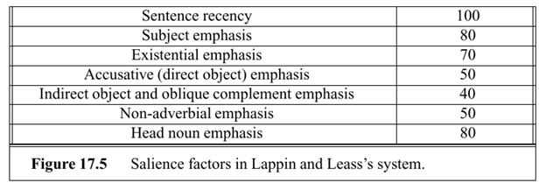
Lappin and Leass Algorithm
The salience factors used and their corresponding weights are

Slide 63
Subject Emphasis
That means the focus is usually on the subject and what the subject does.

Slide 64
Existential Emphasis
It asserts the existence or non-existence of something
English relies on constructions introduced by There
The verb most often used in existential sentences is a form of be. Other verbs (e.g., exist, occur) may follow the existential there.
E.g.
There is always some madness in love
There are many exit visas sold in this café

Slide 65
Accusative (Direct Object) Emphasis
It shows the relationship of a direct object to a verb.
E.g.
We cooked our dinner.
Verb: cooked
Direct object: dinner

Slide 66
Indirect Object Emphasis
The emphasis is on the Indirect Object
E.g.
I made my friend (IO) who came from US some coffee (DO)

Slide 67
Oblique Complement Emphasis
It is prepositional phrase which behaves like a complement
E.g.
Pat will wait for Kim

Slide 68
Adverbial Emphasis
It is a term used for an intensifier used to give added force or a greater degree of certainty to another word in a sentence or a sentence as whole
Adverbs of emphasis are called emphasizers
E.g. absolutely, certainly,clearly,definitely
E.g.
He is tapping my phone and I definitely heard it

Slide 69
Head Noun Emphasis
It is the head of the noun that determines what sort of thing or person the whole noun phrase refers to
E.g.
All the cakes on the table tastes nice
Cakes taste nice

Slide 70
Lappin and Leass Algorithm
The weights that each factor assigns to an entity in the discourse model are cut in half each time a new sentence is processed.
E.g.
An Acura Integra is parked in the lot. (subject)
There is an Acura Integra parked in the lot. (existential predicate
nominal)
John parked an Acura Integra in the lot. (object)
John gave his Acura Integra a bath. (indirect object)

Slide 71
Lappin and Leass Algorithm
The weight for any referent is always positive.
The head noun emphasis factor penalizes referents which are embedded in larger noun phrases.
Once we have updated the discourse model with new potential referents and recalculated the salience values associated with them, we are ready to consider the process of resolving any pronouns that exist within a new sentence.

Slide 72
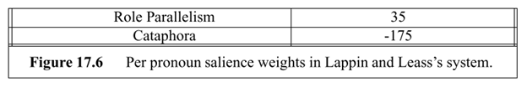
Lappin and Leass Algorithm
Two more salience weights, one for grammatical role parallelism between the pronoun and the potential referent, and one to disprefer cataphoric reference are considered here

Slide 73
Pronoun Resolution Algorithm
1. Collect the potential referents (up to four sentences back).
2. Remove potential referents that do not agree in number or gender with the pronoun.
3. Remove potential referents that do not pass intrasentential syntactic coreference constraints.

Slide 74
Pronoun Resolution Algorithm
4. Compute the total salience value of the referent by adding any applicable values to the existing salience value previously computed during the discourse model update step.
5. Select the referent with the highest salience value. In the case of ties, select the closest referent in terms of string position (computed without bias to direction).

Slide 75
Example
E.g. John saw a beautiful Acura Integra at the dealership. He showed it to Bob. He bought it.
First Sentence : John saw a beautiful Acura Integra at the dealership.
Second Sentence : He showed it to Bob.
Third Sentence : He bought it.

Slide 76
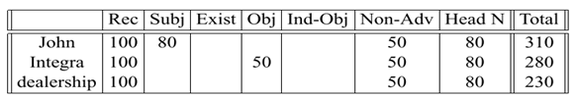
Resolution of First Sentence
First Sentence : John saw a beautiful Acura Integra at the dealership.
There are no pronouns to be resolved in this sentence, so we move on to the next, degrading the above values by a factor of two as shown in the table.

Slide 77
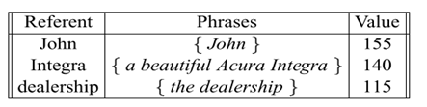
Second Sentence
Second Sentence : He showed it to Bob.
The ﬁrst noun phrase in second sentence is pronoun he.
Because he speciﬁes male gender, Step 2 of the resolution algorithm reduces the set of possible referents to include only John, so we can stop there and take this to be the referent.

Slide 78
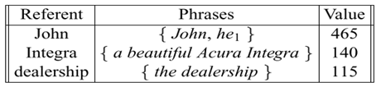
Second Sentence
Second Sentence : He showed it to Bob.
The pronoun is in the current sentence (recency=100), subject position (=80), not in an adverbial (=50), and head noun phrase (=80), and so a total of 310 is added to the current weight for John:

Slide 79
Second Sentence
Second Sentence : He showed it to Bob.
The next noun phrase in the second sentence is the pronoun it, which is compatible with the Integra or the dealership.
For the parallelism preference, both it and a beautiful Acura Integra are in object position within their respective sentences (whereas the dealership is not), so a weight of 35 is added to this option.

Slide 80
Second Sentence
Second Sentence : He showed it to Bob.
With the Integra having a weight of 175 (140+35) and the dealership a weight of 115, the Integra is taken to be the referent.
Discourse model is updated by adding 100(Recency) + 50(Object) + 50(not in an adverbial ) + 80 (Head Noun Phrase)=280 to the current weight for the Integra.

Slide 81

Second Sentence
Second Sentence : He showed it to Bob.
The ﬁnal noun phrase in the second sentence is Bob, which introduces a new discourse referent.
It receives a weight of 100(Recency) + 40(Indirect Object) + 50(not in an adverbial) + 80(Head Noun Phrase)=270.

Slide 82
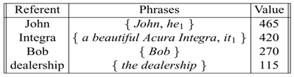
Second Sentence
Second Sentence : He showed it to Bob.
The ﬁnal weights of the second sentence is

Slide 83
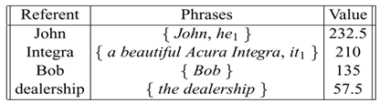
Third Sentence
Third Sentence : He bought it.
The ﬁrst noun phrase in third sentence is pronoun he.
Because he speciﬁes male gender, Step 2 of the resolution algorithm reduces the set of possible referents to John and Bob

Slide 84
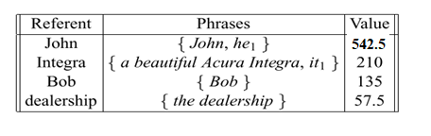
Third Sentence
Third Sentence : He bought it.
Since John is having more score, it is used to resolve he and updated weight of 310 (recency=100, subject position =80, not in an adverbial =50, and head noun phrase =80), is added to the current weight for John:

Slide 85
Third Sentence
Third Sentence : He bought it.
The next noun phrase in the second sentence is the pronoun it, which is compatible with the Integra or the dealership.
For the parallelism preference, both it and a beautiful Acura Integra are in object position within their respective sentences (whereas the dealership is not), so a weight of 35 is added to this option.

Slide 86
Third Sentence
Third Sentence : He bought it.
With the Integra having a weight of 245 (210+35) and the dealership a weight of 57.5, the Integra is taken to be the referent.
Discourse model is updated by adding 100(Recency) + 50(Object) + 50(not in an adverbial ) + 80 (Head Noun Phrase)=280 to the current weight for the Integra.

Slide 87
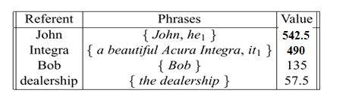
Updated Weights

Slide 88
End

